Slide 1
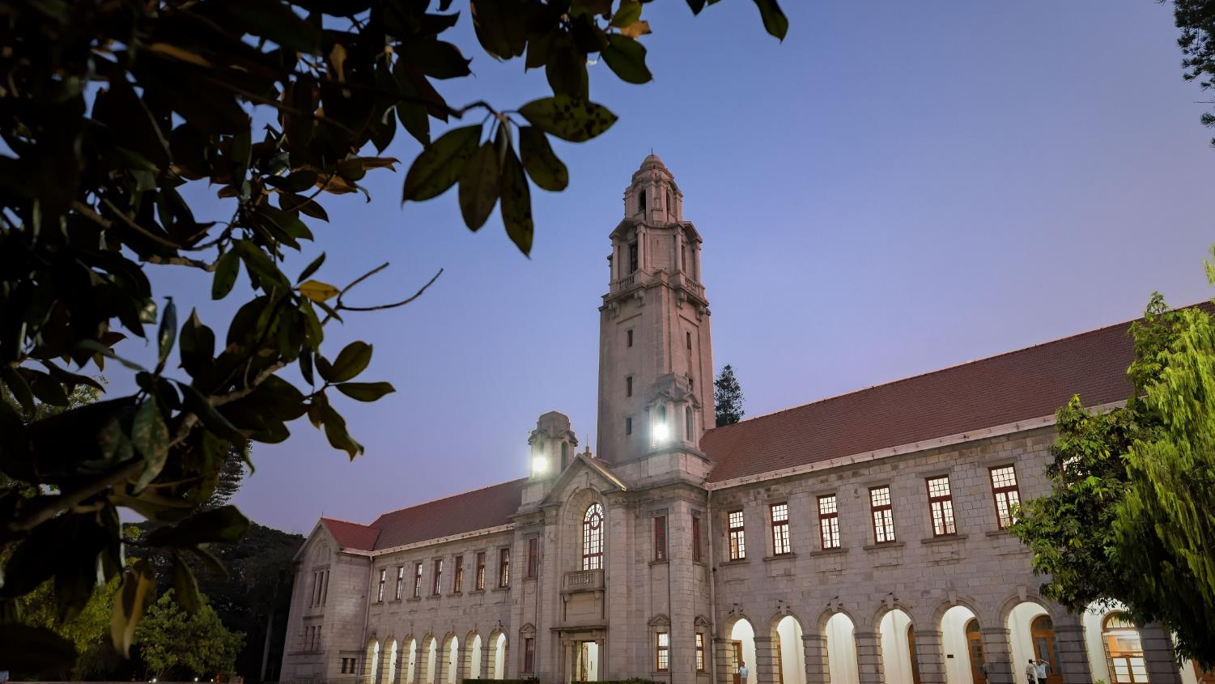

COVID-19 Modelling with the SEIRV Model
Team: TBD
Members: Abhishek Ranjan, Mohd. Zaid, Mahabir Sibam Prasad Senapati, Aditya Kumar
Presenter: Abhishek Ranjan
Indian Institute of Science

Slide 2
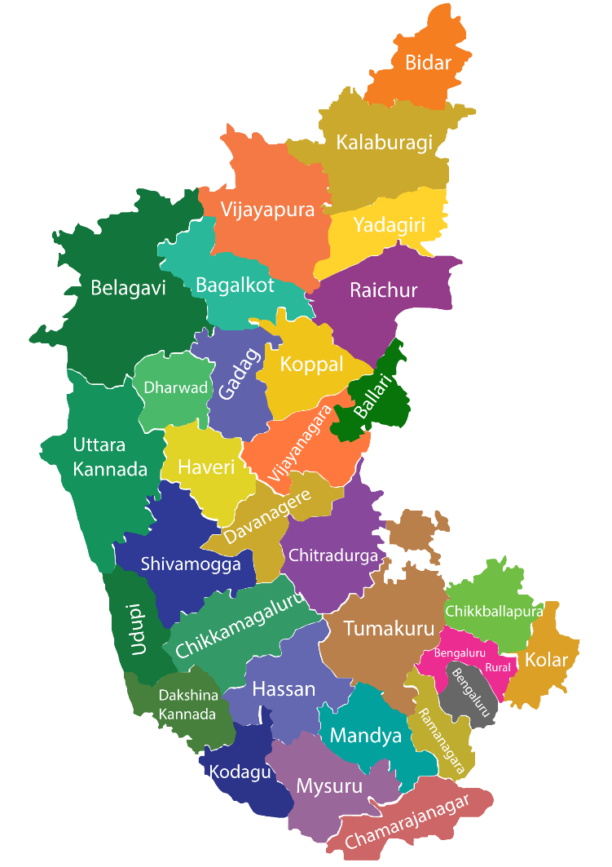
Description of Scope
The aim of this project was to model the evolution of COVID-19 infections across 38 district units in Karnataka, taking into consideration the phenomenon of immunity waning over time and the movement of population between the different units.
We extended the SEIR model used in the assignment to work with all 38 units simultaneously, while also considering the following:
Immunity waning in the recovered population.
Mobility of population between different units.
We calibrated the extended model over various time periods, making the model learn different patterns of evolution over the course of the pandemic.
Another aim of the project was to get the predictions for the number of active cases in the future, extending into 2022. Such predictions would be useful for management and mitigation agencies for planning ahead.
Image credit: ENVIS Center

Slide 3
Methodology – SEIRV Model
We did the data preprocessing to get it in the desired format:
We used the Pandas library in Python 3.
Standardized the names for all the units.
Distributed the test data of Karnataka into all the different units weighted by populations.
Distributed the vaccination and Sero Survey round 2 data of Bengaluru Urban unit into different subunits.
Now in order to get the susceptible population, split the number of active infections into exposed and infected population in a 1:9 ratio.
In order to counter the high variance across the days of the week, we took 7 days running averages on the time series data.
Implemented the traditional SEIRV model:
We implemented the given difference equations in the Next_Instant_Values() function, which returns the next state (S, E, I, R, V values) for the next day given the SEIRV values for the present day.
This function can be called multiple times to calculate the evolution of the model. It is used in this way by the loss functions, which generate SEIRV values over a time period.

Slide 4
Methodology – Parameter Optimization
Loss functions:
We had loss functions for each the tasks. Each of them returns the maximum calculated loss among 38 units.
The first loss function takes the parameters (beta, scale and shape) and initial model state (S0, E0, I0, R0, V0) values as input and returns relative difference between the predicted value and actual reported number of cases on 1st Nov’ 2020.
The second loss function is similar. But it instead calculates the per-day mean squared error between the predicted number of cases and the actual reported values.
For the third and fourth task, the above two losses were reused jointly for calibration.
Optimization method:
We first implemented the naïve gradient descent (used in the assignment). This did not work out very well. We found that it took a lot of time and was unable to converge in a reasonable time.
Going forward we switched to using the SciPy Optimization library (scipy.optimize) functions (minimize, brute) for the optimization. These turned out to work far better, and we were able get within the desired loss threshold.
We mainly used the ‘minimize’ function from scipy.optimize, with the ‘Nelder-Mead’ method. For the third task, we had to switch to the ‘L-BFGS’ method as we were encountering negative contact rates as optimal parameters.

Slide 5
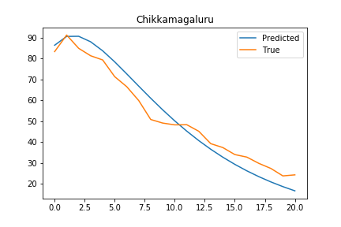
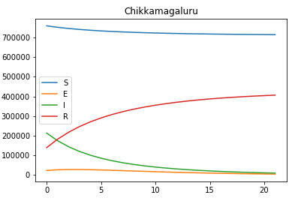
Description of Results – Task 1
Figure 1 plot for predicted and reported cases vs timestep
Figure 1 plot of various parameters vs timestep
From the left figure, we can see that predicted cases are almost the same as reported cases for the 1st Nov’20. 2nd plot shows the general trend of the district Chikkamagaluru for the parameters S, E, I, R. we can see that the susceptible population, and infectious population, have a decreasing trend and recovered populations are increasing. This shows that pandemic is in decaying phase.

Slide 6
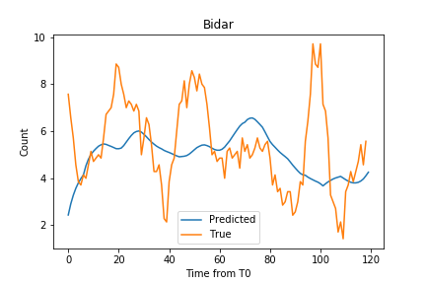
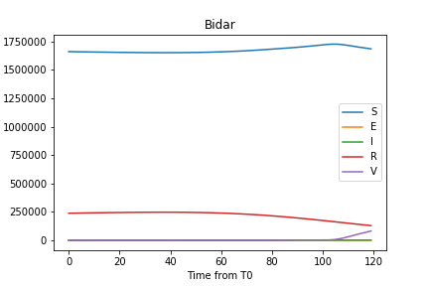
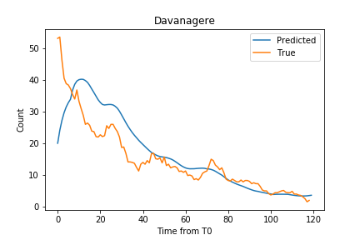
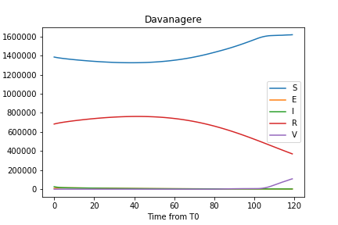
Description of Results – Task 2
For district Bidar, we can observe that the initial predicted number of cases is very different from the actual reported number, but our model follows the general trend very well. However, in the figure 3, the predicted number of cases is almost same except during the initial days.
For district Davanagere, we can see that initially, for a brief number of days, the susceptible population is decreasing and the recovered population is increasing. When immunity waning starts, the recovered population starts decreasing, and the susceptible population increases, which is as expected. We can also see that the vaccinated population also increases as vaccination starts on 18th Jan’2021.
Figure 1 Plot of predicted cases vs reported cases
Figure 2 parameters value of SEIRV model for the given duration
Figure 3 Plot of predicted cases vs reported cases
Figure 2 parameters value of SEIRV model for the given duration

Slide 7
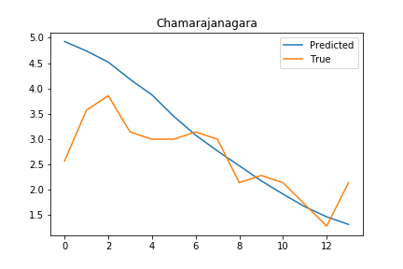
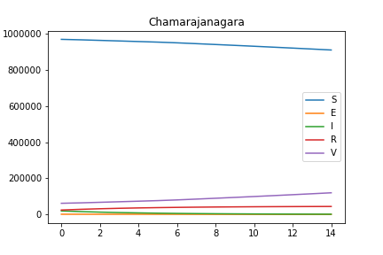
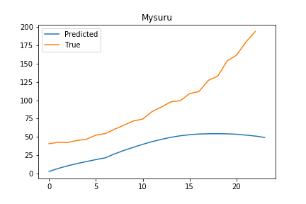
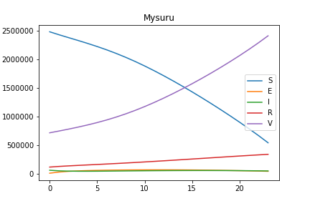
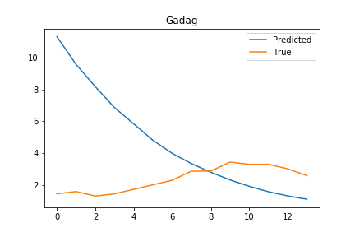
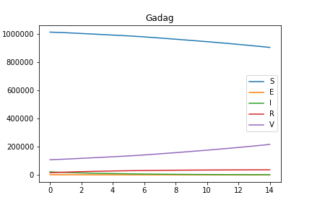
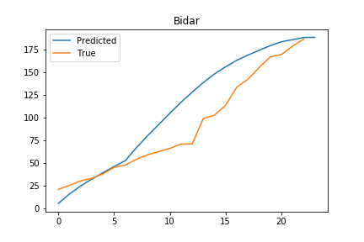
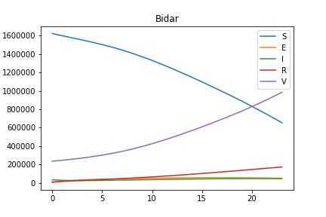
Description of Results – Task 3
Figure 1 Plot of predicted cases vs reported cases
Figure 1 Plot of predicted cases vs reported cases
Figure 2 parameters value of SEIRV model for the given duration
Figure 5 Plot of predicted cases vs reported cases
Figure 6 parameters value of SEIRV model for the given duration
Figure 3 Plot of predicted cases vs reported cases
Figure 4 parameters value of SEIRV model for the given duration
Figure 7 Plot of predicted cases vs reported cases
Figure 8 parameters value of SEIRV model for the given duration
Results after first calibration
Results after second calibration

Slide 8
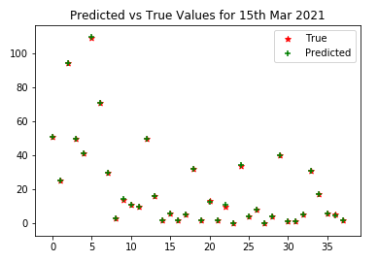
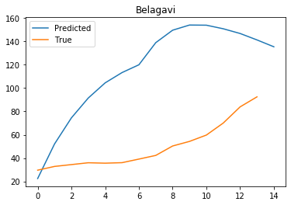
Description of Results – Task 3 & 4
Fig- plot after calibration in task 3
Fig - Plot of predicted vs reported cases in task 4
The problem with the task 4 is that for some units, while optimizing, the contact rate becomes negative and for some units, susceptible population becomes negative after some time.

Slide 9
Discussion and insights
Observations
We had to optimize the Weibull distribution parameters separately for each unit instead of taking the same parameters for all units. This can be explained by the variation in immunity and cautiousness of people living in different regions and cultures.
For Bengaluru Urban, we obtained a relatively small value for the Weibull scale parameter. This means that immunity waning occurs at a faster pace here. This could be a possible support for the hygiene hypothesis, as Bengaluru is a relatively clean and hygienic city.
For the first calibration in task 3 (1st March – 15th March 2021), the predictions were very off even after the optimization. This could be explained by the stochastic nature of actual cases curve. The stochasticity comes from the mobility and the small number of cases in this time period.
Challenges
During the stochastic period for task 3, it was hard to decide how to initialize our model using the Sero Survey round 2 data.
We had to manually perturb and enter good initialization parameters in some cases, for the optimization to work well.

Slide 10
Thank you

